Slide 1



Crop Recommendation using ML

Slide 2

Learning Objectives
Develop an ML model for crop recommendation.
Use soil nutrients, weather conditions, and past yield data.
Aid farmers in making data-driven decisions to boost productivity.
GOAL
Source :
www.freepik.com/

Slide 3




Tools and Technology used
Programming: Python Libraries: Scikit-Learn, Pandas, NumPy Environment: Google collab Data Sources: Crop datasets

Slide 4
Methodology
1. Data Collection: Gather soil, climate, and crop yield data. 2. Preprocessing: Clean and normalize data for training. 3. Feature Engineering: Identify key factors affecting crop yield. 4. Model Training: Train models like Random Forest, SVM, XGBoost. 5. Deployment: Develop a web or mobile-based recommendation system.

Slide 5
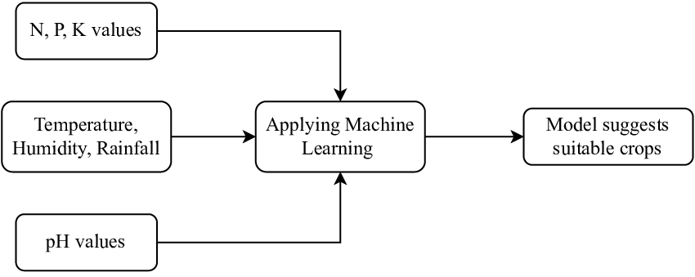
Problem Statement:
Farmers struggle to choose the right crops due to unpredictable weather conditions, soil fertility variations, and lack of decision-making tools.
This leads to low yield and economic losses.

Slide 6
Solution:
Analyzing Soil, Climate, and Yield Data
Our machine learning model processes soil nutrient levels, local climate data (temperature, rainfall, humidity), and historical yield records to recommend the best crops suited to the region.
Real-Time Data Integration
Integrate real-time soil and weather data using IoT sensors, providing up-to-date insights to farmers for accurate decision-making.
Predicting Crop Yield and Maximizing Efficiency
By analyzing past yield data, the model predicts potential crop yields, helping farmers manage their resources more effectively and maximize productivity.
User-Friendly Interface
A web or mobile-based platform allows farmers to easily input their region's data and receive crop recommendations, making the technology accessible to everyone, regardless of technical expertise

Slide 7
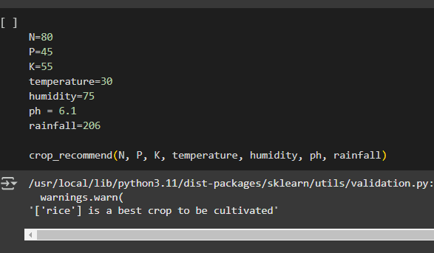
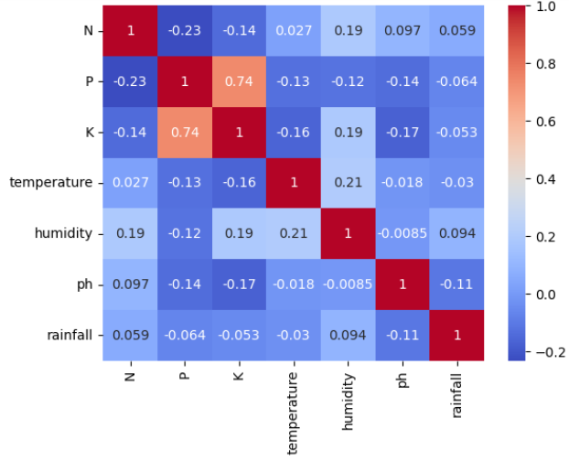
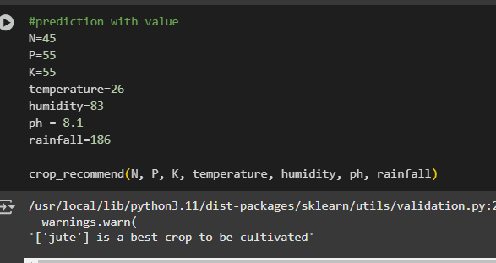
Screenshot of Output:

Slide 8
Conclusion:
Data-Driven Crop Recommendations:
Machine learning can effectively analyze environmental factors to recommend the best crops for specific regions.
Increased Productivity:
By using weather, soil, and yield data, farmers can make informed decisions, leading to better crop selection and higher yields.
Empowering Farmers:
This solution helps farmers move beyond traditional practices, providing them with modern tools to optimize their resources, reduce risks, and improve economic stability.
Future Potential:
With continuous improvement and more data, the system can evolve to offer even more

